Slide 1
Week 10
Physical Security

Slide 2
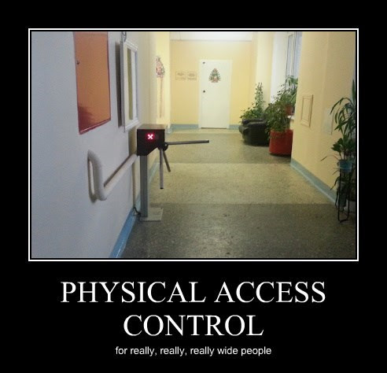
What is Physical Security and why is it important?
Overlooked problem
What does physical access mean
Why is it dangerous?
https://en.wikipedia.org/wiki/Physical_security

Slide 3
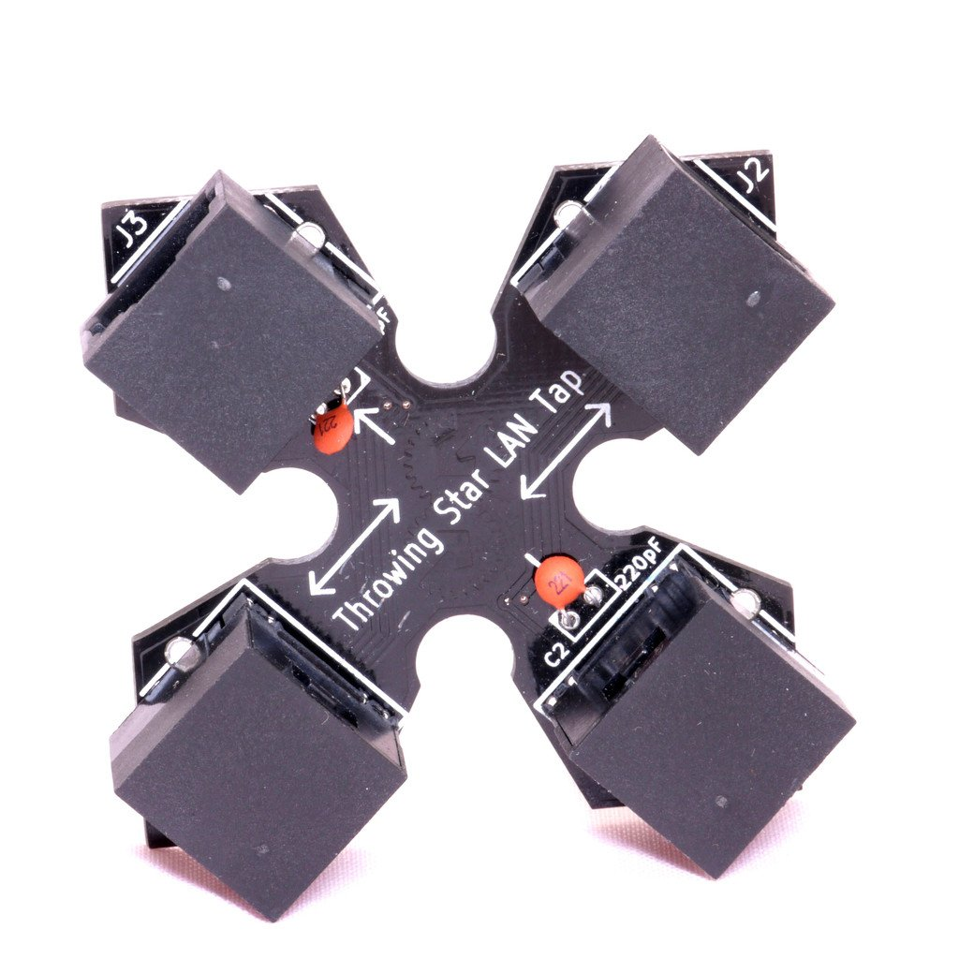
Things that are overlooked
Servers
Network Cables (LAN tap example)
Data storage
Backups
https://hakshop.com/products/throwing-star-lan-tap

Slide 4
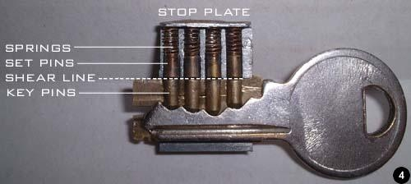
Physical Security
Legality?
Lock sport in security community
Lock sport with demo and activity!
https://en.wikipedia.org/wiki/Lock_picking

Slide 5
Protecting systems
Operating systems
  Updates tricking users into updates
    Waterholes
  Secure Boot/ locking the BIOS
  Remote Updates, forced updates,
  Getting users to update
Applications
  Flash
  Trust, who to trust, websites wanting trust
  Signed Updates

Slide 6
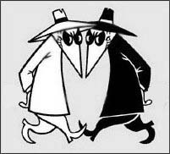
Allowlisting and denylisting
Allowlists
Denylists
  You'll still see whitelist and blacklist in older tools, documentation, and job postings. The industry is moving away from them because they tie white to good and black to bad, and the new terms say what the list does
Example of Chromebooks
Example of corporate systems mobiles

Slide 7
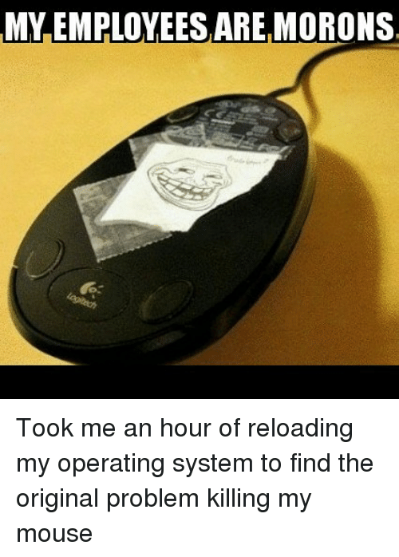
Peripheral Threats
Devices
  Printers
  Routers
  Copiers
  Fax machines
  USB
  iDevices
  Phones
What happens to them after use?

Slide 8
Threats and Countermeasures
Threats | Countermeasure
USB viruses, physical damage, exfiltration | Control USB ports and locks
Loss of mobile devices | Nuke options, encryption, locators
Penetration of facility | Staff training, security controls (locks and cameras)
Data theft | Encryption, data governace, secure storage areas

Slide 9
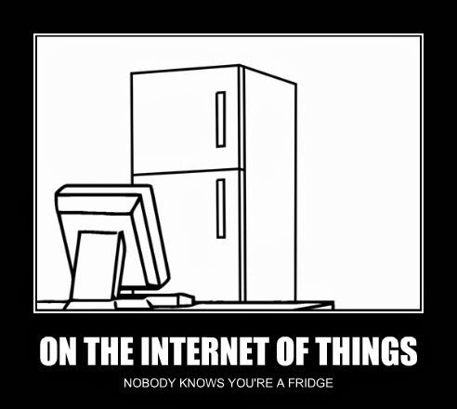
IoT A New Threat
Smart home devices
Business issues
  example vending machines on wifi

